Slide 1



EXCHANGE TRADE LIFE CYCLE

Slide 2

DISCLAIMER
The training content and delivery of this presentation is confidential, and cannot be recorded, or copied and distributed to any third party, without the written consent of Imarticus Learning Pvt. Ltd.

Slide 3

YOU ARE GOING TO LEARN…
Introduction to Trades
Types of Orders
Participants in Exchange Trades
Exchange Traded (ETD) Life Cycle
US Markets Equity Trade Life Cycle

Slide 4
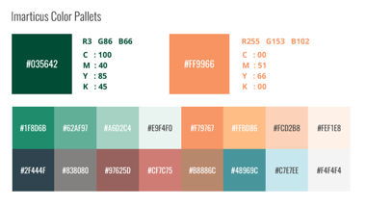

Exchange Traded (ETD)
Life Cycle

Slide 5
TRADE LIFE CYCLE
What is a trade?
In finance and economics, a "trade" refers to the act of buying or selling a financial asset or a good and services with the expectation of receiving something of value in return. Trades are fundamental transactions that occur in various markets and are the basis for economic activity.
Exchange of Ownership: A trade involves the transfer of ownership or rights to an asset, whether it's a financial instrument (e.g., stocks, bonds, currencies, commodities) or physical goods and services (e.g., cars, electronics, labor). In financial markets, ownership is typically represented by securities or contracts.
Buyer and Seller: A trade involves at least two parties: a buyer and a seller. The buyer is the party acquiring the asset or service, while the seller is the party providing it. In financial markets, buyers are often referred to as "long" and sellers as "short."

Slide 6
TRADE LIFE CYCLE
Mutual Agreement: Both the buyer and the seller must agree to the terms of the trade. This includes agreeing on the price, quantity, and any other relevant terms and conditions. The agreement can be explicit or implied, depending on the nature of the transaction.
Consideration: In a trade, there is typically a consideration, which is the value given by one party to the other in exchange for the asset or service. Consideration can take the form of money, other assets, goods, services, or a combination thereof.

Slide 7
TRADE LIFE CYCLE
Intent: Trades are conducted with the intent of achieving specific goals. Buyers may seek to profit from price increases (capital gains), while sellers may aim to lock in profits, manage risk, or fulfill contractual obligations.
Marketplaces: Trades often occur in organized marketplaces or platforms designed to facilitate buying and selling. These marketplaces can be physical, such as stock exchanges, or digital, such as electronic trading platforms.

Slide 8
TRADE LIFE CYCLE
Features of an order
An order in the context of financial markets and trading refers to a specific instruction given by a trader or investor to buy or sell a financial instrument. Orders are essential for executing trades in an organized and systematic manner. Each order has distinct features that define its characteristics and how it should be executed.
Instrument to Be Traded: An order specifies the financial instrument or asset that the trader intends to buy or sell. This can include stocks, bonds, commodities, currencies, options, futures contracts, or other tradable assets.

Slide 9
TRADE LIFE CYCLE
Order Type: The order type determines how the trade should be executed. Common order types include:
Market Order: A market order is executed immediately at the prevailing market price. It prioritizes speed of execution over price.
Limit Order: A limit order specifies a specific price at which the trader is willing to buy (limit buy order) or sell (limit sell order). It is executed only at or better than the specified price.
Stop Order: A stop order becomes a market order when the market reaches a specified price level (stop price). It is often used to limit losses or trigger entry into a trade.
Stop-Limit Order: Similar to a stop order, but it becomes a limit order instead of a market order when the stop price is reached.

Slide 10
TRADE LIFE CYCLE
Market-on-Close (MOC) Order: A market order to be executed at or near the closing price of the trading day.
Fill-or-Kill (FOK) Order: An order that must be executed in its entirety immediately or not at all.
Immediate-or-Cancel (IOC) Order: An order that must be executed immediately, with any unexecuted portion canceled.
Quantity: The quantity specifies the number of units or contracts of the asset that the trader wants to buy or sell. It can range from a single unit to thousands or more.

Slide 11
TRADE LIFE CYCLE
Price: For limit orders, the price indicates the specific price at which the trader is willing to buy or sell. Market orders are executed at the current market price.
Duration: Orders can have different durations, indicating how long the order remains active in the market. Common durations include:
Day Order: Valid for the current trading day.
Good-Til-Canceled (GTC) Order: Remains active until executed or canceled by the trader.
Fill-or-Kill (FOK) Order: Must be executed immediately or canceled.
Immediate-or-Cancel (IOC) Order: Must be executed immediately, with any unexecuted portion canceled.

Slide 12
TRADE LIFE CYCLE
Order Trigger: Some orders, like stop orders, require a trigger condition to be met before they become active. The trigger condition is typically a specific price level.
Routing Instructions: Traders can specify how they want the order to be routed to the market or exchange. For example, they may choose to send the order to a specific exchange or route it through a particular trading platform.
Order ID and Timestamp: Each order is assigned a unique identifier (Order ID) and includes a timestamp indicating when the order was placed. These details are crucial for tracking and record-keeping.

Slide 13
TRADE LIFE CYCLE
Order Instructions: Traders can include additional instructions with their orders, such as special handling requests, time constraints, or specific execution instructions.
Regulatory Compliance: Orders must comply with relevant regulations and market rules, including order size limitations, circuit breakers, and other regulatory requirements.
A trade with the above details, can only be done with the help of market participants and settlement cycle of each markets
SETTLEMENT CYCLE
MARKET PARTICIPANTS

Slide 14
PARTICIPANTS IN EXCHANGE TRADE LIFE CYCLE
1. EXCHANGES
2. EXCHANGE BROKERS/MEMBERS/STO (Securities Trading Organisation)
3. CLIENTS OF STO - HNIs, Family Offices, Institutional Investors, Corporate Treasuries.
4. CLEARING HOUSE - CLEARING CORPORATION
5. CLEARING BROKERS / MEMBERS
6. CUSTODIAN BANKS
7. DATA SERVICE PROVIDERS
8. TECHNOLOGY SERVICE PROVIDERS
9. CENTRAL SECURITIES DEPOSITORIES
10. SECURITIES MARKETS REGULATORY BODIES

Slide 15
TRADE LIFE CYCLE
Trading Activities ( Front Office)
Trade Initiation
Trade Execution
Trade Reporting
Trade Capture
Middle Office
Trade Enrichment
Trade Validation
Trade Verification
Back Office
Trade Confirmation
Transaction Reporting
Trade Settlement
Trade Reconciliation

Slide 16
TRADE INITIATION
Below are the mandatory process to be followed before we can start trading for the client
It starts with the below process :-
KYC Check - Regulations require you first to do KYC check your customers during the onboarding process and then follow their financial transactions
AML Check - Anti-money laundering (AML) refers to the activities financial institutions perform to achieve compliance with legal requirements to actively monitor for and report suspicious activities.
Set Up New Client on RDM - Accounts are created in the internal system of STO, these accounts are called as fund number. All the required information of the customer are stored in here, which is useful for later for verification, trends, performance and valuation

Slide 17
TRADE INITIATION
Trade initiation is the first stage in the trade life cycle and marks the beginning of the process where a trader or investor decides to initiate a trade by buying or selling a financial instrument. This stage involves specifying the key trade details, including the asset, quantity, price, and trade date.
1. Trading Decision:
The trade initiation process begins when a trader or investor decides to enter into a trade. This decision is typically based on various factors, including market analysis, investment strategy, risk tolerance, and market conditions.
Traders may have different motivations for initiating a trade, such as profit generation, risk management, portfolio rebalancing, or hedging against market movements.

Slide 18
TRADE INITIATION
2. Selection of Financial Instrument:
The trader selects the financial instrument in which they want to trade. This could be stocks, bonds, commodities, foreign exchange (forex), options, futures contracts, or any other tradable asset class.
The choice of financial instrument depends on the trader's investment objectives and the opportunities they perceive in the market.
3. Determination of Trade Direction:
Traders decide whether they want to buy (take a long position) or sell (take a short position) the selected financial instrument.
The direction of the trade is based on the trader's outlook for the asset's price movement. For example, if a trader believes the price will rise, they may initiate a buy order (going long).

Slide 19
TRADE INITIATION
4. Trade Quantity:
Traders specify the quantity or volume of the financial instrument they want to trade. The quantity can range from a single share to thousands or more, depending on the trader's investment strategy and available capital.
The trade quantity should align with the trader's risk management and portfolio allocation goals.
5. Trade Price:
Traders determine the price at which they are willing to execute the trade. The specified price is known as the "limit price."
The limit price can be set at a specific price level, or it can be based on market conditions, such as the current market price or a certain price range.

Slide 20
TRADE INITIATION
6. Trade Date:
The trader selects the trade date, which is the date on which they want the trade to be executed. The trade date may be the same day as the trade initiation (a "spot trade") or a future date (a "forward trade").
The choice of trade date can be influenced by factors like market timing, settlement considerations, and trading strategy.
7. Order Type:
Traders may choose from various order types to specify how they want their trade to be executed. Common order types include market orders, limit orders, stop orders, and more.
Each order type has specific execution instructions and risk considerations.

Slide 21
TRADE INITIATION
8. Broker Selection:
If the trader uses a brokerage firm to execute the trade, they select the broker through which they will place the trade. Broker selection may depend on factors such as brokerage fees, execution speed, research tools, and market access.
9. Trade Instructions:
Traders provide specific instructions to the broker or trading platform, including details like the chosen order type, quantity, limit price, and trade date.
Trade instructions ensure that the trade is executed according to the trader's intentions.
10. Compliance and Regulatory Considerations:
Traders and investors must consider regulatory requirements and compliance issues when initiating a trade. These requirements can vary depending on the type of asset, market jurisdiction, and the trader's legal obligations.

Slide 22
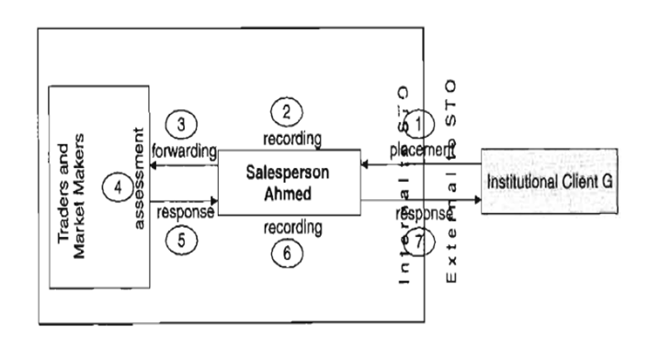
TRADE EXECUTION

Slide 23
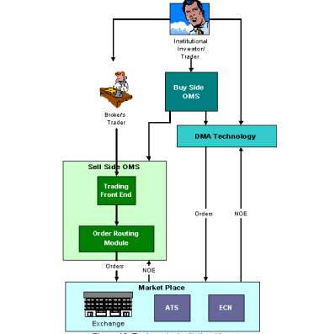
TRADE EXECUTION

Slide 24
TRADE EXECUTION
Trade execution is a crucial stage in the trading process where a trader's order to buy or sell a financial instrument is carried out in the market. It involves the actual matching of the order with a counterparty, either manually or electronically, and the completion of the transaction. Trade execution is a critical step that determines the price at which the trade is executed and has a significant impact on a trader's profitability.
Order Receipt:
Trade execution begins when the trading platform or broker receives the trader's order. This order can be of various types, such as market orders, limit orders, or stop orders, each with its specific execution characteristics.
Order Validation:
The order is validated to ensure that it meets the market's requirements and regulatory standards. This validation includes checks for order size, price levels, and other constraints set by the market.

Slide 25
TRADE EXECUTION
Order Routing:
Once the order is validated, it is routed to the relevant market or exchange. The choice of where to route the order can depend on factors like market liquidity, order type, and execution speed. Some orders may be executed on electronic trading platforms, while others may go to a traditional stock exchange.
Order Matching:
In the market or exchange, the trader's order is matched with a counterparty willing to take the opposite side of the trade. For example, a buy order is matched with a sell order, and vice versa.
The order matching process typically occurs through an order book or central limit order book (CLOB), where buy and sell orders are listed at different price levels. Orders are matched based on the "price-time priority" rule, where orders at the same price level are executed in the order they were received.

Slide 26
TRADE EXECUTION
Price Determination:
The price at which the trade is executed is determined by the market conditions and the specific order type.
For market orders, the execution price is the current market price at the time the order is matched. Market orders prioritize speed of execution over price certainty.
For limit orders, the execution price is the specified limit price or better. Limit orders prioritize price control over execution speed.
For stop orders, the execution price becomes a market order when a specific trigger price is reached.

Slide 27
TRADE EXECUTION
The most important function of an Order Management System is ‘Order Capture’ which flows down to trade support and settlement systems.
Trade Initiation from BUY SIDE
Buy side clients are Investment Manager of an Mutual Fund, Hedge Funds etc.
An Investment Manager can initiate trade order via
Through sell side - Will contact broker/ trader directly
Through buy side OMS -
To Sell side - via FIX system
Through DMA technology
This then flows to the multiple markets as it can connects to Exchanges, ECNs, etc.
Macgregor, Charles River Investment Management System etc. are examples of buy side OMS.
“Direct Market Access (DMA)” that allows firms to route orders to all market destinations. Lava Trading, RealTick and FlexDMA are examples of DMA based applications.
With DMA, buy side customers are renting a broker's infrastructure and clearing via the broker, but they are controlling the order. The real motivation for aggressive DMA trading on the buy side is cheaper commissions as compared to routing the order to sell side.

Slide 28
TRADE EXECUTION
The most important function of an Order Management System is ‘Order Capture’ which flows down to trade support and settlement systems.
Trade Initiation from SELL SIDE
Examples some popular Sell side OMS includes GL Trade, Fidessa, Davidge Data Systems, NYFIX etc.
When the trader executes the order in the BUY SIDE/ SELL SIDE workstation, it can either go to electronic exchange such as NASDAQ etc. via Electronic Communication Network (ECN) or go to manual exchanges such as NYSE.
Notes:
Without ECNs, it would take considerably longer for buyers and sellers to be matched with one another, making it more difficult to enter or exit positions and adding to the costs and risks of trading. ECNs connect major brokerages and individual traders so they can trade directly between themselves without going through a middleman.

Slide 29
TRADE REPORTING
1. Purpose of Trade Reporting
Ensures market transparency: everyone can see executed prices and volumes.
Facilitates price discovery and helps market participants make informed decisions.
Enables regulators to monitor market activity and detect irregular trading patterns.
Provides a basis for risk assessment and surveillance.
2. Timing of Trade Reporting
Occurs immediately after trade execution.
For exchange-traded instruments: usually real-time or near real-time, automated by the exchange.
Always before clearing and settlement, so regulators can monitor exposures and obligations.
3. Who Reports : Exchange or broker reports automatically.
4. Example
Institutional Investor buys 100000 shares of Reliance on NSE at ₹1,500:
Exchange automatically reports trade details (instrument, price, quantity, timestamp) to regulators.
Market participants see price and volume for transparency
Notes:
Without ECNs, it would take considerably longer for buyers and sellers to be matched with one another, making it more difficult to enter or exit positions and adding to the costs and risks of trading. ECNs connect major brokerages and individual traders so they can trade directly between themselves without going through a middleman.

Slide 30
TRADE CAPTURE
Trade capture is a process to book a transaction into a front-office trading system, such as inputting all trade details in the official book of record system, linking all reference data, and calculating profit and loss
The successful capture of a trade within a trading system should result in the trade details being sent to the middle office immediately
The trading system should perform validation that all necessary components of a trade are present, before assigning a trade reference to the trade.
ORDER MANAGEMENT SYSTEM
Trading book • Trade date • Trade time • Value date • Operation • Quantity • Security • Price • Counterparty
RISK MANAGEMENT SYSTEM
Update the trading position for the specific security (typically within a trading book), so that factual trading position is reflected in the trader's records. • Update the average price of the current trading position so that when the next trade is executed, the trader or market maker knows whether a trading profit or loss will be made.

Slide 31
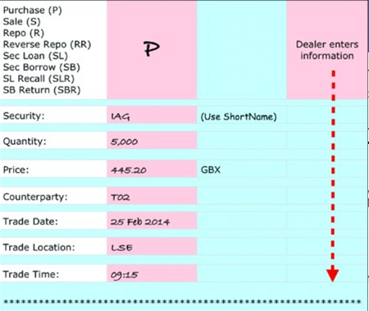
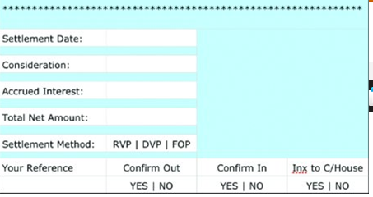
TRADE CAPTURE - TRADE TICKET
The information contained in the dealing sheet will be submitted to the Middle Office either electronically or manually using a trade ticket. Illustrates an example of a trade ticket

Slide 32
TRADE ENRICHMENT
Trade enrichment is achieved through defaulting relevant information automatically from the store of information within static data is commonly known as Data Defaulting.
Trade Enrichment Factors
Cash values defaults – Trade Figuration
Custodian defaults
SSI defaults
Trade confirmation defaults
Transaction reporting defaults
Notes:
The Middle Office will start the process of making each transaction ready for clearing. This involves the following activities:
Ensuring that the dealer has entered all the required information on the trade ticket.
Calculating the purchase costs or sale proceeds. This will include accrued interest for bonds, stamp duty for equities (where appropriate) and brokerage fees for client transactions. For simplicity, we will not consider stamp duty for our settlement simulation example.
Updating the company's risk profiles. This includes ensuring that the individual dealer is authorised to trade these particular assets and whether or not the dealer has exceeded trading limits. With equities in particular, it is also important to ensure that any post-trade positions do not breach disclosure levels (in the event that they do, these positions need to be disclosed to the appropriate authorities).
Ensuring that the quantity of securities traded is an exact multiple of that security's board lot size.

Slide 33
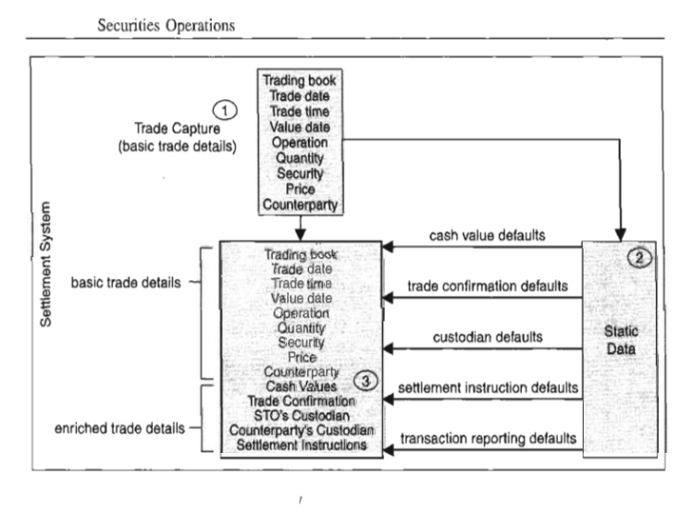
TRADE ENRICHMENT
Notes:
The Middle Office will start the process of making each transaction ready for clearing. This involves the following activities:
Ensuring that the dealer has entered all the required information on the trade ticket.
Calculating the purchase costs or sale proceeds. This will include accrued interest for bonds, stamp duty for equities (where appropriate) and brokerage fees for client transactions. For simplicity, we will not consider stamp duty for our settlement simulation example.
Updating the company's risk profiles. This includes ensuring that the individual dealer is authorised to trade these particular assets and whether or not the dealer has exceeded trading limits. With equities in particular, it is also important to ensure that any post-trade positions do not breach disclosure levels (in the event that they do, these positions need to be disclosed to the appropriate authorities).
Ensuring that the quantity of securities traded is an exact multiple of that security's board lot size.

Slide 34
TRADE ENRICHMENT - CASH VALUES DEFAULTS – TRADE FIGURATION
Trade figuration means calculating trade cash values. It involves the determination of the net amount (NSV) of a securities transaction.
Accrued Interest - Accrued interest is applicable on straight bonds, but not on zero coupon bonds.
Client purchases of UK equity attract stamp duty, but sales do not.
Only sellers of US equity are required to pay a Securities & Exchange Commission fee.
Stamp duty is payable on Irish equities, but not on Japanese equities.
Notes:
The Middle Office will start the process of making each transaction ready for clearing. This involves the following activities:
Ensuring that the dealer has entered all the required information on the trade ticket.
Calculating the purchase costs or sale proceeds. This will include accrued interest for bonds, stamp duty for equities (where appropriate) and brokerage fees for client transactions. For simplicity, we will not consider stamp duty for our settlement simulation example.
Updating the company's risk profiles. This includes ensuring that the individual dealer is authorised to trade these particular assets and whether or not the dealer has exceeded trading limits. With equities in particular, it is also important to ensure that any post-trade positions do not breach disclosure levels (in the event that they do, these positions need to be disclosed to the appropriate authorities).
Ensuring that the quantity of securities traded is an exact multiple of that security's board lot size.

Slide 35
TRADE ENRICHMENT - SSI DEFAULTS
The Standard Settlement Instructions (SSIs) specify how a trade is to be settled. SSIs are added to trading accounts based on requests from Middle/Back Office.
The below fields are important for the process of adding SSIs to an account: •
Place of Settlement - Custodian / Depository
Currency of Settlement
Delivering Agent - Nostro and Depot Account
Receiving Agent - Nostro and Depot Account
Notes:
The Middle Office will start the process of making each transaction ready for clearing. This involves the following activities:
Ensuring that the dealer has entered all the required information on the trade ticket.
Calculating the purchase costs or sale proceeds. This will include accrued interest for bonds, stamp duty for equities (where appropriate) and brokerage fees for client transactions. For simplicity, we will not consider stamp duty for our settlement simulation example.
Updating the company's risk profiles. This includes ensuring that the individual dealer is authorised to trade these particular assets and whether or not the dealer has exceeded trading limits. With equities in particular, it is also important to ensure that any post-trade positions do not breach disclosure levels (in the event that they do, these positions need to be disclosed to the appropriate authorities).
Ensuring that the quantity of securities traded is an exact multiple of that security's board lot size.

Slide 36
TRADE ENRICHMENT - SSI DEFAULTS
Settlement instructions need to be send to custodian or depository immediately once the trade comes from Front office to Middle office
Standard Settlement Instructions (SSI) Defaults added -
Custodian may have a preferred (but different) method of transmission.
For instance: company A may choose to transmit via telex, whereas company B may choose to transmit via S.W.I.F.T.
For example: custodian X may require all settlement instructions to be transmitted via a specific S.W.I.F.T. message type, whereas custodian Y may require the transmission of all such instructions via a different S.W.I.F.T. message.
Notes:
The Middle Office will start the process of making each transaction ready for clearing. This involves the following activities:
Ensuring that the dealer has entered all the required information on the trade ticket.
Calculating the purchase costs or sale proceeds. This will include accrued interest for bonds, stamp duty for equities (where appropriate) and brokerage fees for client transactions. For simplicity, we will not consider stamp duty for our settlement simulation example.
Updating the company's risk profiles. This includes ensuring that the individual dealer is authorised to trade these particular assets and whether or not the dealer has exceeded trading limits. With equities in particular, it is also important to ensure that any post-trade positions do not breach disclosure levels (in the event that they do, these positions need to be disclosed to the appropriate authorities).
Ensuring that the quantity of securities traded is an exact multiple of that security's board lot size.

Slide 37
TRADE VALIDATION
STOs adopt a final check of the data contained within a fully enriched trade, in order to reduce the possibility of erroneous information being sent to the outside world. This activity is known as trade validation, a mechanism to reduce risk and remain in control. Unless an STO performs validation of trade information at this stage of the trade lifecycle, there is a risk that:
Timely and accurate servicing of clients
Avoidance of operational risk and cost

Slide 38
TRADE VALIDATION
Relevant Rules set in the Data Management
Components | Rules | Components | Rules
Trading Book | may be restricted to specific traders | Price | bond price must be either a percentage relevant to face value or a yield.
Trade date | should be ‘today’ for a new trade | Counterparty | must include location of counterparty.
Trade time | cannot be in the future. | Trade Cash Value | must be quantity x price (unit or percentage) plus or minus other costs such as stamp where relevant
Value date | is normally the standard settlement cycle for the security group (e.g. T+2 for Europe) | Trade Confirmation | should be sent to institutional clients
Quantity | must be multiples of the minimum denomination of a bond | Company's and Counterparty 's Custodians | must be relevant to the security group.
Security | cannot be a matured bond

Slide 39
TRADE VERIFICATION
Here the trade is compared with the Trade Sheet i.e. an email/excel file sent from Front Office to Middle Office. This step is done to ensure that the details that the Front Office has sent to the client and what is booked is correct
This is the step Pre settlement reconciliation, done as part of the internal recon process.
Here we ensure that all the transaction booked in FO has passed in the middle office.

Slide 40
TRADE CONFIRMATION
A trade confirmation, often referred to simply as a "confirmation," is a document generated after a financial trade has been executed. It provides detailed information about the trade to both the buyer and the seller, serving as an official record of the transaction. Trade confirmations are a crucial part of the trade processing cycle and play a significant role in maintaining transparency, reducing disputes, and facilitating regulatory compliance. Here's an in-depth explanation of trade confirmation:
1. Content of a Trade Confirmation:
A trade confirmation typically contains the following key information:
Trade Details: This includes the asset traded (e.g., stock, bond, currency pair, commodity), the quantity of the asset, and the execution price.
Trade Date: The date on which the trade was executed.
Value Date / Settlement Date: The date on which the trade will be settled, which is when ownership and payment will be exchanged. (VD and SD in some cases can be different)

Slide 41
TRADE CONFIRMATION
Counterparty Information: Details about the buyer and the seller, including their names, addresses, and account information.
Trade Reference Number: A unique identifier for the trade, which is used for tracking and record-keeping.
Trade Venue: Information about where the trade was executed, such as the stock exchange, electronic trading platform, or over-the-counter (OTC) market.
Execution Time: The precise time at which the trade was executed.
Order Type: The type of order used for the trade (e.g., market order, limit order, stop order).
Trade Currency: The currency in which the trade was executed.

Slide 42
TRADE CONFIRMATION
2. Distribution of Trade Confirmations:
Trade confirmations are typically sent to both the buyer and the seller shortly after the trade has been executed. In some cases, a copy may also be provided to a clearinghouse or central counterparty (CCP) for clearing and settlement purposes.
For institutional and retail investors, trade confirmations are often delivered electronically through email, online trading platforms, or secure messaging systems.
3. Trade Confirmation Frequency:
The frequency of trade confirmations can vary depending on the financial market and the nature of the trade. In some markets, such as equities, confirmations are generally sent on the same day as the trade execution & Instaneous.

Slide 43
TRADE CONFIRMATION
4. Legal and Regulatory Requirements:
Trade confirmations serve as legal documents that provide evidence of the terms and conditions of the trade. They are subject to regulatory requirements, which may vary by jurisdiction and asset class.
Regulatory requirements often dictate the content and timing of trade confirmations, as well as any specific disclosures that must be included.
5. Risk Management and Dispute Resolution:
Trade confirmations play a vital role in risk management and dispute resolution. By providing a detailed record of the trade, they help traders and investors verify that the trade has been executed correctly and in accordance with their instructions.
In the event of disputes or discrepancies, trade confirmations serve as evidence that can be used to resolve issues between counterparties.

Slide 44
TRADE CONFIRMATION
6. Record-Keeping and Audit Trail:
Trade confirmations are essential for maintaining accurate records of all trading activities. They create a comprehensive audit trail that can be used for compliance, accounting, and regulatory reporting purposes.
These records are typically retained for a specified period to meet regulatory requirements.

Slide 45
TRADE CONFIRMATION
Broker sends a trade confirmation to the client via an electronic trade matching platform or through an excel/pdf.
The client compares the trade details with their internal OMS.
Both the economic and non-economic details of the trade will be matched by the client.
Once the trade has been confirmed by the client - the broker will send the details to the custodian and/or depository/clearing house. The client will also send the trade details to their custodian.

Slide 46
TRADE TRANSACTION REPORTING
Purpose of Transaction Reporting
Provides regulators with client-level trade data for monitoring compliance.
Helps in detecting market abuse, insider trading, and suspicious activity.
Supports AML/KYC compliance and risk monitoring by regulatory authorities.
Enables regulators to track positions, exposures, and overall market risk at the participant level.
Transaction reporting can be achieved by
Transmission originated by the member of a specific message, part of which is used for transaction reporting
Trax where a single message sent by an ISMA member serves the purpose of trade matching as well as transaction reporting, with the relevant information forwarded by ISMA to the regulator
Transmission of a settlement instruction to a national central securities depository (NCSD), that then forwards the necessary information to the regulator, for example: Crest (UK).

Slide 47
TRADE TRANSACTION REPORTING
MiFID II (2018)
Transaction Reporting Scope: Significantly expanded compared to MiFIDI.Covers all financial instruments, including:
Equities
Bonds
Derivatives (exchange-traded & OTC)
Structured products
ETFs
Purpose: Enhanced market surveillance, risk monitoring, and detection of market abuse.Supports ESMA’s monitoring and oversight across all EU markets.
Content of reports: Much more detailed and includes Client identifiers (LEI – Legal Entity Identifier), Order types, Buy/sell indicators
Venue of execution, Price, quantity, and timestamps, Reporting timestamps
Key Improvements:
Introduced unique transaction identifiers (UTI) to link related trades, Expanded reporting to OTC derivatives that were previously excluded., Stricter deadlines for submission (usually T+1)., Improved data quality requirements for regulators.

Slide 48
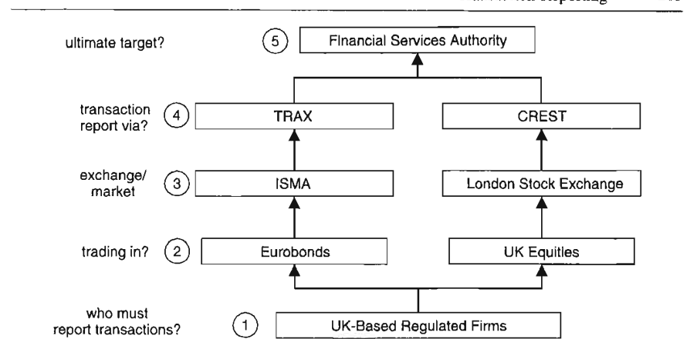
TRADE REPORTING

Slide 49
TRADE SETTLEMENT
It starts with clearing and then settlement.
Clearing/clearance is defined as: “. Clearance is the preparation for settlement and takes place in a central system known as either a clearing house or a central counterparty”.
As part of the settlement process, clearing systems will match both sides to any transaction and check that there is sufficient asset availability before advising a CSD that the transaction can settle.
Clearance is the preparation for settlement and takes place in a central system known as either a clearing house or a central counterparty.
Determination of obligations of both parties helps parties to know their net payment/ receipt of both cash and securities by TD+1 day, making sure parties are ready with the both.

Slide 50
TRADE SETTLEMENT
Sometimes the term is used (imprecisely) to include settlement. ”Settlement is defined as: “The completion of a transaction, wherein the seller transfers … securities or financial instruments to the buyer and the buyer transfers money to the seller.
The settlement agent can now make the settlement on the SD.
Pay-In funds and securities
Pay-out funds and securities

Slide 51
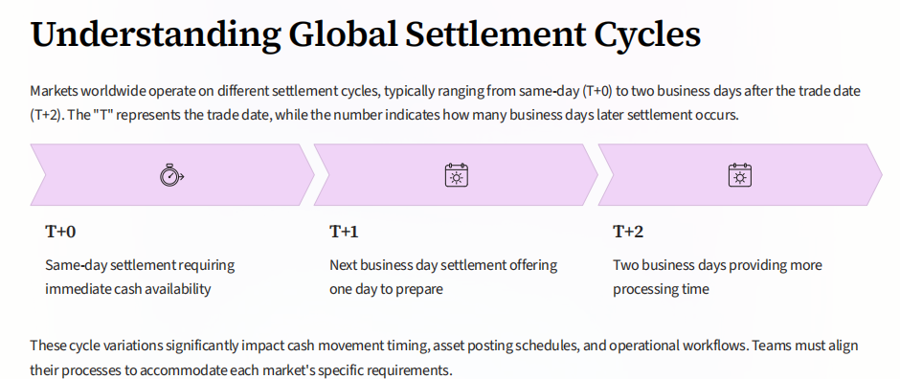
CASH/SPOT MARKET SETTLEMENT CYCLES

Slide 52
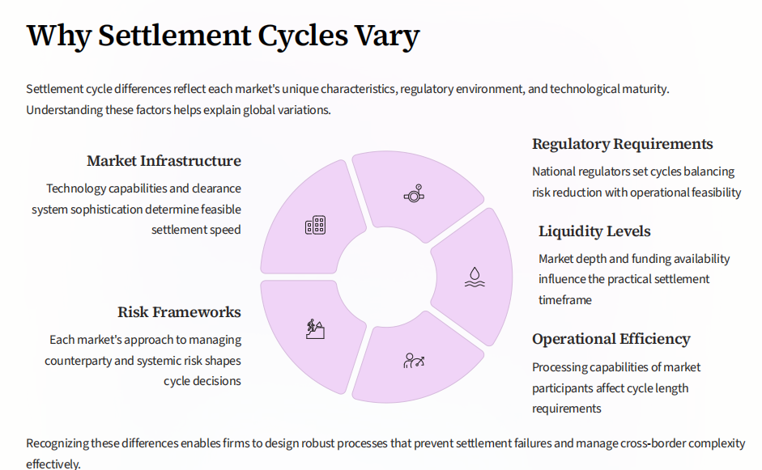
SETTLEMENT CYCLES

Slide 53
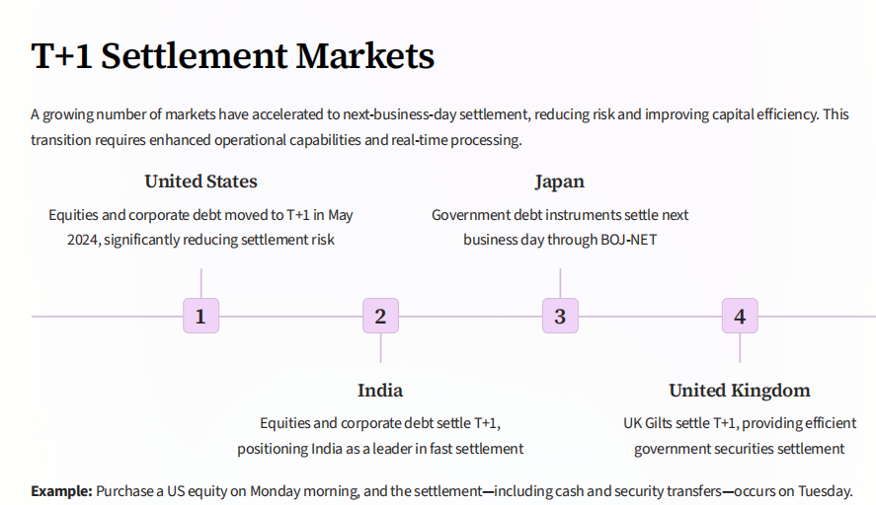
T+1 Settlement Cycles

Slide 54
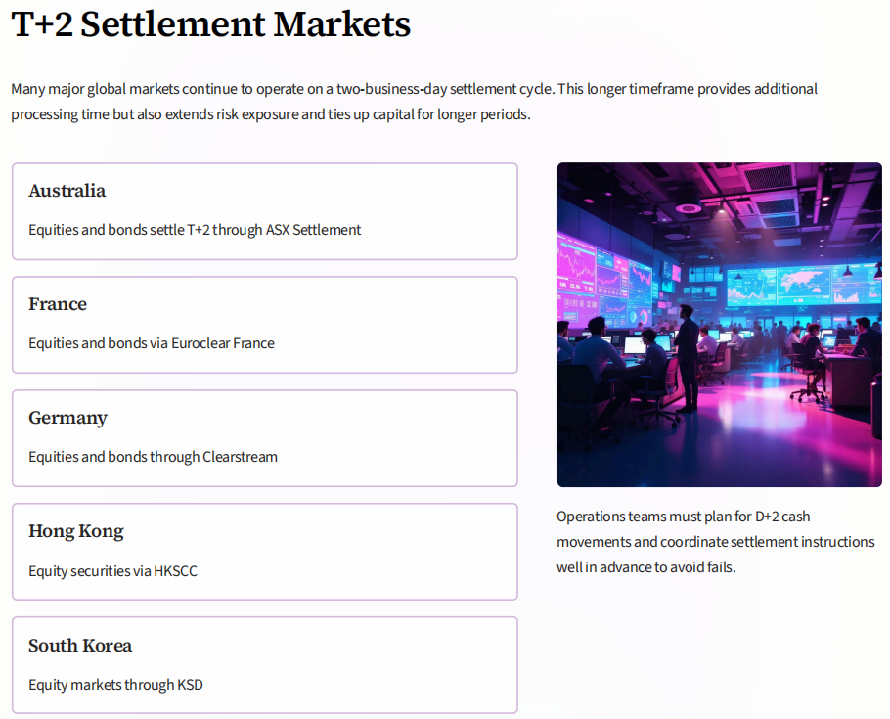

Slide 55
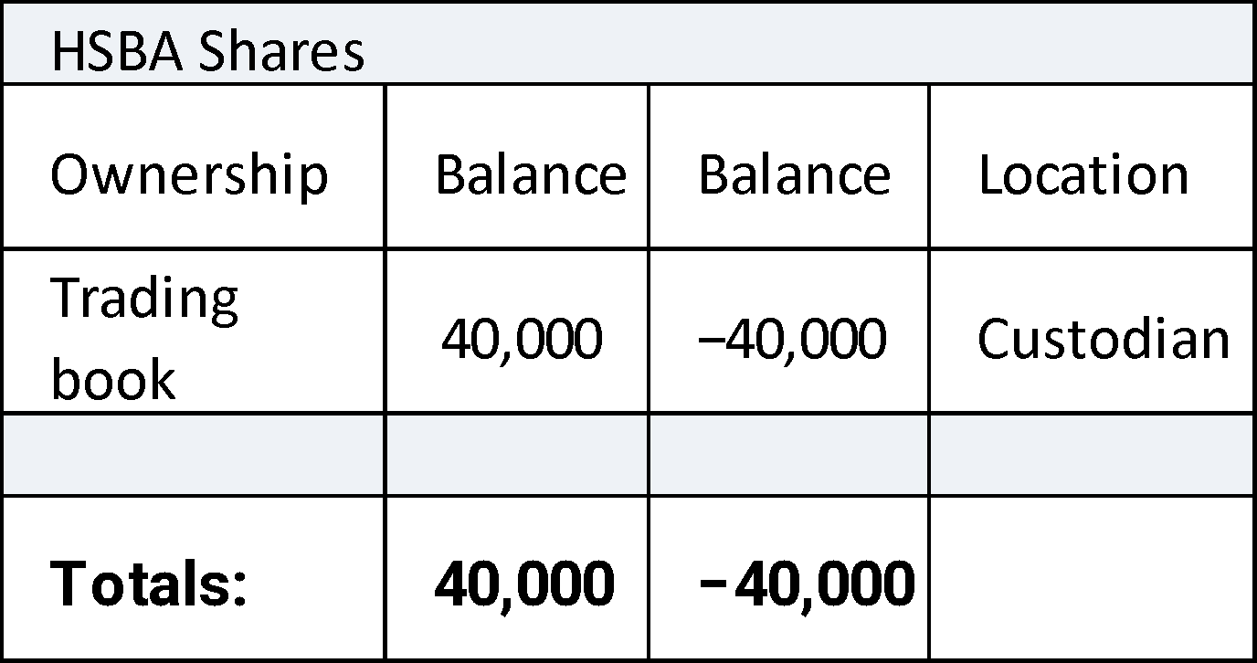
TRADE RECONCILIATION
Reconciliation is the Control Process by which 2 or more sets of data are compared and any discrepancies are investigated and documented through to resolution, including formal reporting and escalation.
Reconciling positions and trades within internal books and records with the outside world is paramount in ensuring that the STO remains in control of its assets and liabilities
Reconciliation helps an STO remaining in control of its stocks and cash and is fundamental to successful and efficient operation of its business through maintaining up-to-date internal records.

Slide 56
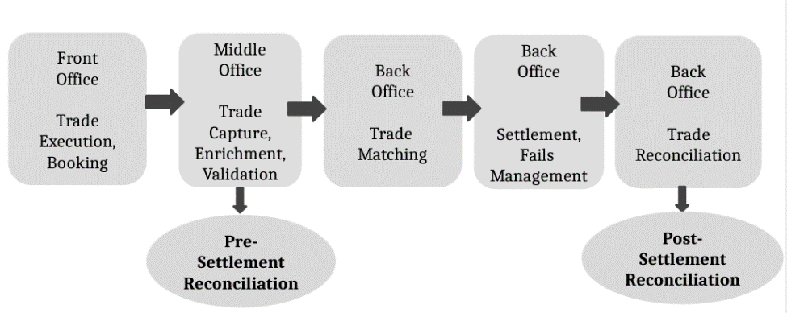
TRADE RECONCILIATION
Where does it figure in the TLC?
Front Office: Trade Execution, Booking
Middle Office: Trade Capture, Enrichment, Validation (Pre-Settlement Reconciliation)
Back Office: Trade Matching Back Office: Settlement, Fails Management, Trade Reconciliation (Post-Settlement Reconciliation)

Slide 57
TRADE REPORTING
Upon receipt, the regulator analyses the transaction detail and attempts to identify unusual patterns of trading, which may have been caused by, for example:
Market manipulation, or
Insider trading, and
Significant errors (on the part of the STO).
OBJECTIVE is the identification of breaches of trading rules

Slide 58





Life Cycle of a Typical U.S. Equity Trade
Buy
Broker/
STO
Order / Execution
NYSE / NASDAQ / ECNs
Broker/ STO
Sell
Order
Order
Locked-in
CLIENT
Trade
CLIENT
Confirm
NSCC
Confirm
Matching
Netted Settlement Instructions
DTCC
Book Entry Receive
Book Entry Delivery
Custodian
Custodian

Slide 59



THANK YOU !!!
Contact us today! https://imarticus.org/

